Slide 1
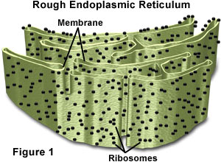
ROUGH ENDOPLASMIC RETICULUM
Prepared by:
Jomar M. Urbano
2SED-SC
Ms. Aimie M. Aquino
Professor

Slide 2
Learning Objectives:
R.E.R.
Recognize the discoverers of Endoplasmic reticulum.
Describe Rough Endoplasmic Reticulum (RER) in terms of structures and functions.
What ribosomes are.
Types of Ribosomes.
Roles of RER in protein glycosylation.
Roles of RER in protein sorting.

Slide 3
Introduction
R.E.R.
How do you travel from home to school? Do you take a road or sidewalk?
Roads and sidewalks give people a path to follow as we move about our cities. A cell also has a system of tiny roads. These roads are actually tubes called the endoplasmic reticulum. Endoplasmic means "within the plasm" and reticulum means "network".

Slide 4
Introduction
R.E.R.
The endoplasmic reticulum (ER) is a network of folded membranes that form channels. They extend from the cell membrane through the cytoplasm to the nuclear membrane.

Slide 5
Who discovered ER?
R.E.R.
The ER was discovered in 1945 by Albert Claude in Belgium and Keith Porter at Rockefeller Institute. It was first noticed in the cytoplasm of chick embryo cells.

Slide 6
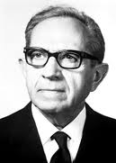
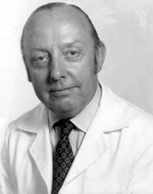
Who discovered ER?
R.E.R.
Albert Claude
Keith Porter

Slide 7
What makes ER rough?
It’s because of the Ribosomes.

Slide 8
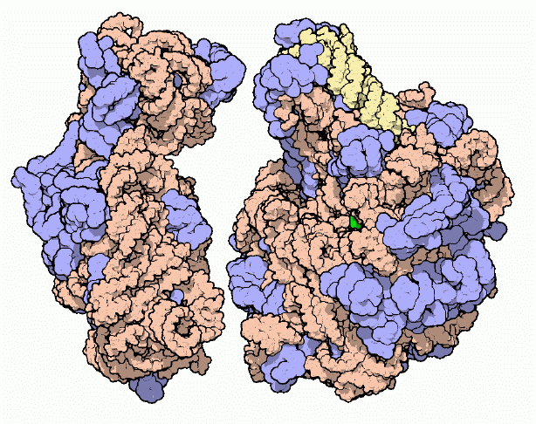
What is Ribosome?
R.E.R.
Site of protein synthesis.
Small Subunit
Large Subunit

Slide 9
Types of Ribosomes
R.E.R.
Free – suspended in cytoplasm.
Bound – attached to ER.

Slide 10
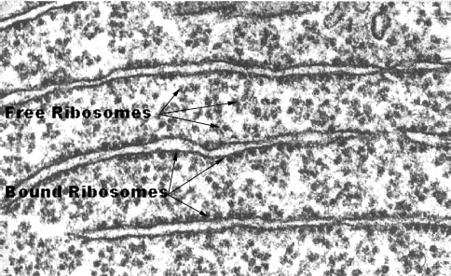
Types of Ribosomes
R.E.R.
Visualized on an Electron Micrograph

Slide 11
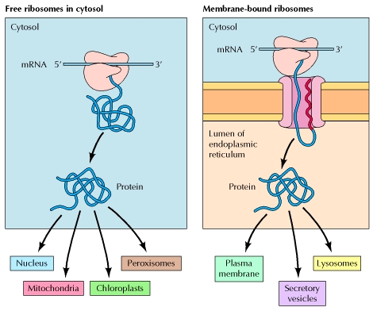
Types of ribosomes: Overview of protein sorting
R.E.R.

Slide 12
Free Ribosomes
R.E.R.
Create protein that function in the cytoplasm.
Example: Carbohydrate enzymes.

Slide 13
Bound Ribosomes
R.E.R.
Membrane insertion
Packaging within organelles (Lysosomes)
Secretory proteins (pancreatic cells)

Slide 14
George Palade
R.E.R.
In the mid 1950's, George Palade discovered that the amount of RER in a cell corresponds to the quantity of protein a cell exports.
Example: White blood cells that produce infection fighting immune system proteins (called antibodies) have highly developed RER.

Slide 15
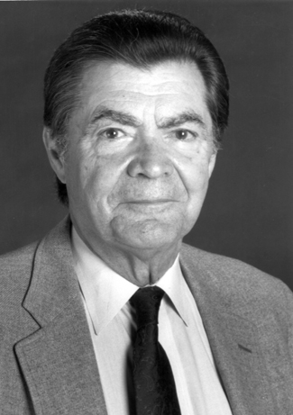
George Palade
R.E.R.
George Palade

Slide 16
What is Rough Endoplasmic Reticulum (RER)?
R.E.R.
The RER is studded with ribosomes that form granules on the surface to give it a "rough" appearance.
The RER is involved in the synthesis of proteins.

Slide 17
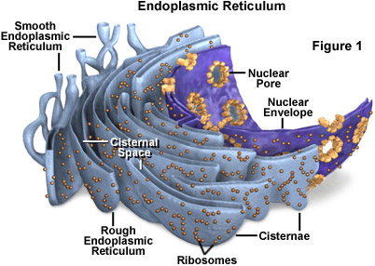
Structure: Rough Endoplasmic Reticulum (RER)
R.E.R.

Slide 18
Structure: Rough Endoplasmic Reticulum (RER)
R.E.R.
Visualized on an Electron Micrograph of a Animal Cell

Slide 19
Function: Rough Endoplasmic Reticulum (RER)
R.E.R.
Involves in the synthesis of proteins that usually use outside the cell.

Slide 20
Glycosylation
R.E.R.
A form of co-translational and post-translational modification.
Glycans serve a variety of structural and functional roles in membrane and secreted proteins.
Majority of proteins synthesized in the RER undergo glycosylation.

Slide 21
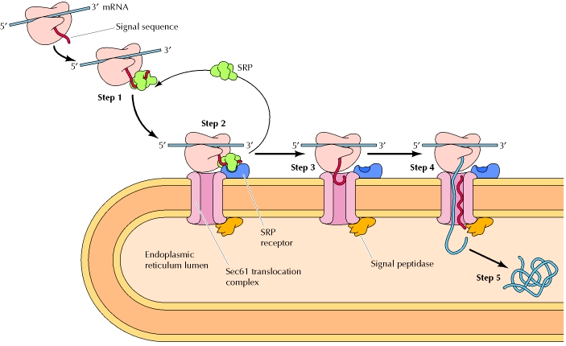
Co-translational targeting of secretory proteins to the ER
R.E.R.
SRP: Signal Recognition Particle

Slide 22
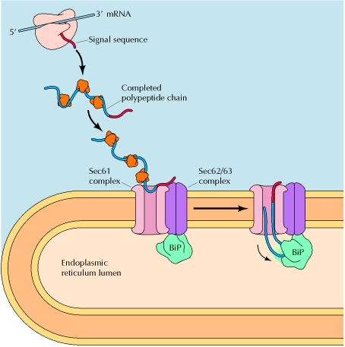
Post-translational translocation of proteins into the ER
R.E.R.
Cytosolic Chaperones
Molecular Chaperones

Slide 23
Glycans
R.E.R.
N-linked glycans attached to a nitrogen of asparagine or arginine side-chains. N-linked glycosylation requires participation of a special lipid called dolichol phosphate.

Slide 24
Glycans
R.E.R.
O-linked glycans attached to the hydroxy oxygen of serine, threonine, tyrosine, hydroxylysine, or hydroxyproline side-chains, or to oxygens on lipids such as ceramide.

Slide 25
Glycans
R.E.R.
Phospho-glycans linked through the phosphate of a phospho-serine.

Slide 26
Glycans
R.E.R.
C-linked glycans a rare form of glycosylation where a sugar is added to a carbon on a tryptophan side-chain.

Slide 27
Glycans
R.E.R.
Glypiation, which is the addition of a (Glycosylphosphatidylinositol)GPI anchor that links proteins to lipids through glycan linkages.

Slide 28
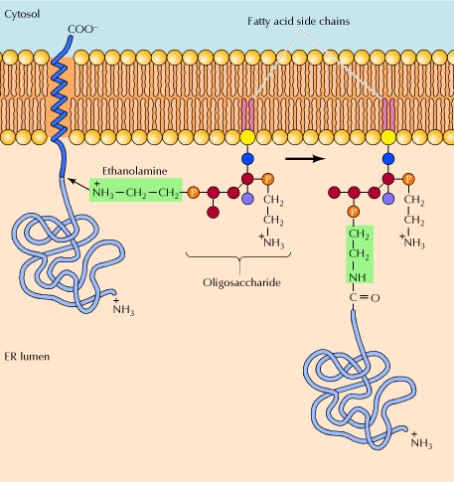
Addition of GPI anchors
R.E.R.

Slide 29
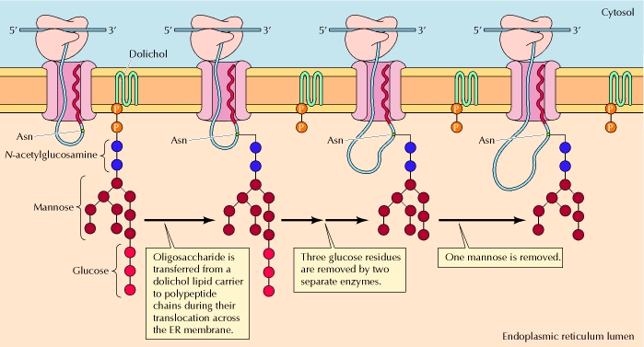
Glycosylation
R.E.R.

Slide 30
Types of ribosomes: Overview of protein sorting
R.E.R.

Slide 31
Protein Sorting
R.E.R.
The initial sorting of proteins to the ER takes place while translation is in progress. Proteins synthesized on free ribosomes either remain in the cytosol or are transported to the nucleus, mitochondria, chloroplasts, or peroxisomes.

Slide 32
Protein Sorting
R.E.R.
In contrast, proteins synthesized on membrane-bound ribosomes are translocated into the ER while their translation is in progress. They may be either retained within the ER or transported to the Golgi apparatus and, from there, to lysosomes, the plasma membrane, or the cell exterior via secretory vesicles.

Slide 33
From RER → Golgi Apparatus
R.E.R.
Once a protein has been synthesized (made), Rough ER creates a bubble around it by pinching off a portion of its own membrane. This bubble is called a “transition/transport vesicle.” The transition vesicle then moves either to the cell membrane or to the Golgi Apparatus.

Slide 34
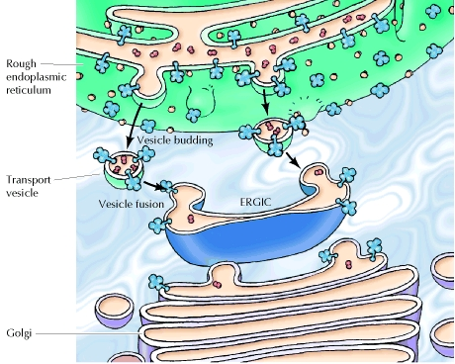
Vesicular transport from the ER to the Golgi Apparatus
R.E.R.

Slide 35
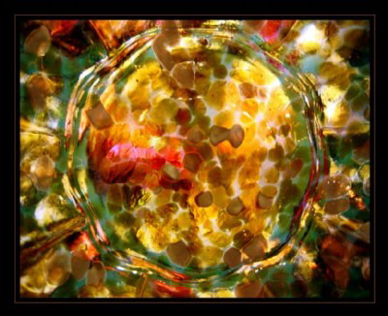
☺ END ☺
R.E.R.
REFERENCE: http://www.ncbi.nlm.nih.gov/books/NBK9889/
http://library.thinkquest.org/C004535/golgi_apparatus.html

