Slide 1
SMOOTH ENDOPLASMIC RETICULUM
Prepared by:
Jomar M. Urbano
2SED-SC
Ms. Aimie M. Aquino
Professor

Slide 2
Learning Objectives:
S.E.R.
Describe Smooth Endoplasmic Reticulum (SER) in terms of structure.
Functions of Smooth Endoplasmic Reticulum

Slide 3
Introduction
S.E.R.
The Smooth Endoplasmic Reticulum (SER) is seen as a tangle of interconnected tubules.
Unlike the rough ER, it lacks ribosomes or relatively few ribosomes attached.
The smooth ER is continuous with the rough ER but has different functions and structure.

Slide 4
STRUCTURE
S.E.R.

Slide 5
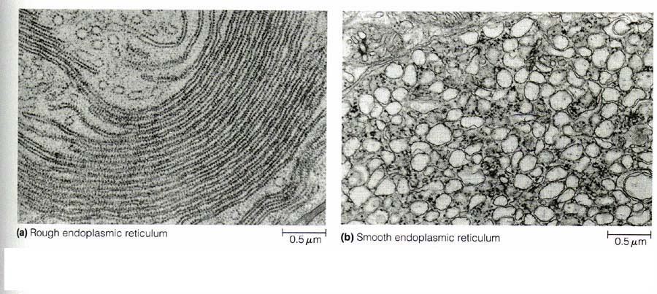
STRUCTURE
S.E.R.

Slide 6
Smooth Endoplasmic Reticulum
S.E.R.
Name: smooth endoplasmic reticulum, smooth ER, tubular endoplasmic reticulum, agranular endoplasmic reticulum
Location: in cytoplasm
Appearance: interconnected and branching tubules; relatively few/no ribosomes
Size: tubules are about 150nm in diameter (variable)

Slide 7
FUNCTIONS
S.E.R.
Stores/Regulation of calcium ions
Drug detoxification
Carbohydrate metabolism
Synthesis of steroids and lipids
Transportation of newly synthesized proteins

Slide 8
Stores/Regulation of calcium ions
S.E.R.
In case of muscle cells, this endoplasmic reticulum stores calcium, which is released during contraction of the muscles.

Slide 9
Detoxification
S.E.R.
The SER is highly developed in liver cells and has the function of detoxification.
Any substance carried in the circulation can be rapidly acted on by the liver where the metabolism or “elimination” of lipophilic substances such as drugs, anesthetics, pesticides, toxins, and hormones takes place .

Slide 10
Carbohydrate Metabolism
S.E.R.
Liver cells store carbohydrates in the form of glycogen.
The breakdown of glycogen eventually leads to the release of glucose from the liver cells, which is important in the regulation of sugar concentration in the blood.

Slide 11
Synthesis of steroids and lipids
S.E.R.
Enzymes of the smooth ER are vital to the synthesis of lipids, including oils, phospholipids, and steroids.

Slide 12
Transportation of newly synthesized proteins
S.E.R.
Another function is transportation of newly synthesized proteins to other locations in the cell or outside the cell.
This is achieved through a process called budding, wherein the small vesicles, which contain proteins, are detached from the smooth endoplasmic reticulum and are carried to other locations.

Slide 13
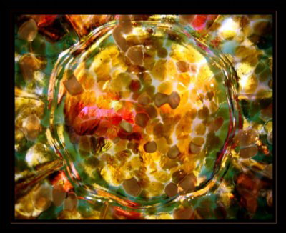
☺ END ☺
S.E.R.
REFERENCE: http://www.buzzle.com/articles/smooth-endoplasmic-reticulum.html
http://www.en.wikipedia.org/wiki/Endomembrane_system

