Slide 1
FOOD ISSUES

Slide 2
INTRODUCTION
Genetically Modified Organisms or “GMO’s” –
any organism that has an altered gene or undergoes genetic engineering

Slide 3
Genetically Modified Foods
Also known as “GMF’s” –
any organism that has an altered gene or undergoes genetic engineering for food production.

Slide 4
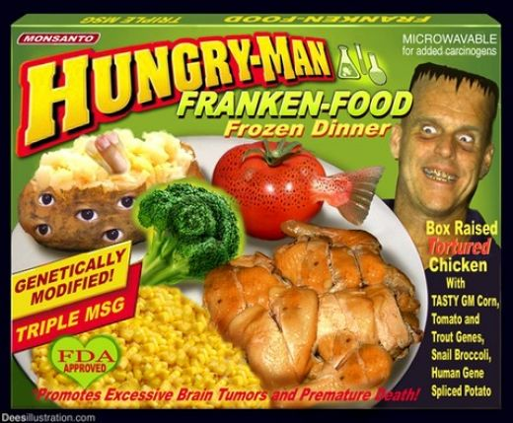
Frankenfood
It was named by anti-GM food groups. Other term for GMF’s

Slide 5
FOOD ISSUES
• Potential safety risk for humans
• Potential safety risk for environment
• Genetic Engineering is unethical

Slide 6
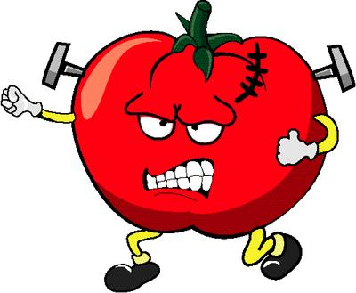
Potential safety risk for humans
Allergic – it is the reaction made by the allergen causing diseases or sickness.
Toxicity – the amount of toxin that may harm an organism.

Slide 7
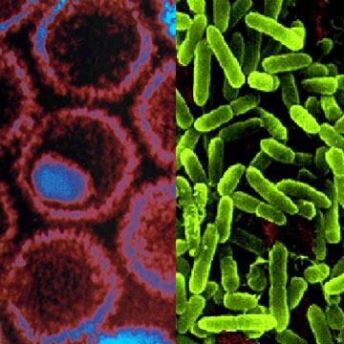
Potential safety risk for environment
SUPERBUGS – since many of the “vectors” used to introduce genes to plants and animals are bacteria and viruses, it is realistic to think there is a chance they could undergo a mutation and prove harmful.

Slide 8
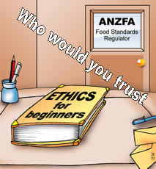
Genetic Engineering is unethical
The following food types have a variety with human genes added: rice (immune system genes that prevent diarrhea), baby food (lactoferrin and lysozyme) and any farm animal (Human growth hormone

Slide 9
☺ END ☺

