Slide 1
ALTERING OF
ANIMALS

Slide 2
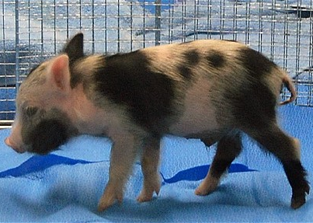
Extinction of Traditional Breeds
There will be a possibility of extinction of the original animal breed

Slide 3
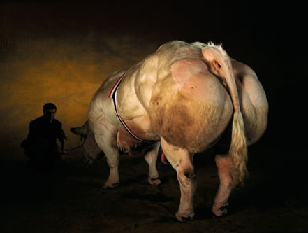
Genetic Diversity Decline
Its “usefulness” destroyed by our quest for faster, better, and more economical products.

Slide 4
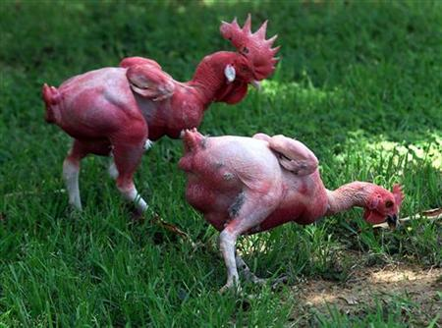
Invasive Techniques
Surgery or other invasive techniques that create the potential for pain.

Slide 5
Genetic Transfer in Animals
Transgenic – an organism whose genome has been changed by the addition of a gene from another species.

Slide 6
Genetic Transfer: Reasons
For greater production efficiency of farm animals.
As a possible aid in the use of livestock to produce medicine.
As tissue for human transplant.

Slide 7
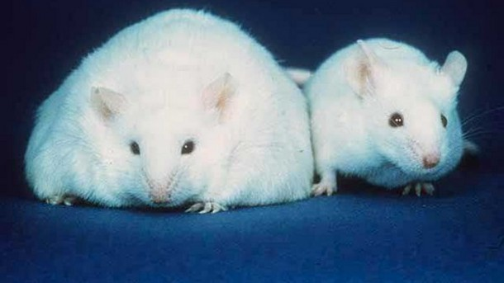
Genetic Transfer: Methods
Microinjection – is a method of gene transfer in which DNA is injected into the embryo of an organism.

Slide 8
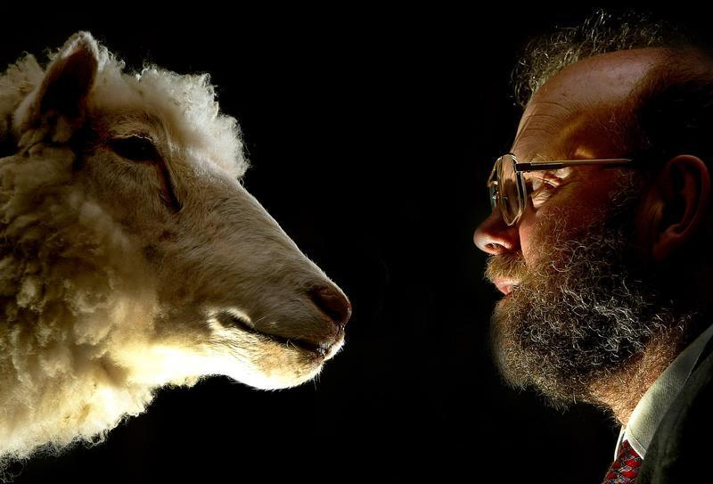
Genetic Transfer: Methods
Cloning – the production of a cloned embryo by transplanting the nucleus of a somatic cell into an ovum.

Slide 9
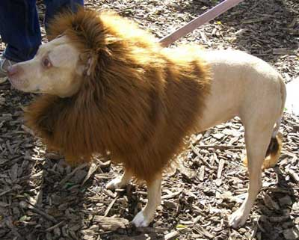
Genetic Transfer: Methods
Splice Gene – A method of combining genes of different animal, species or breed.

Slide 10
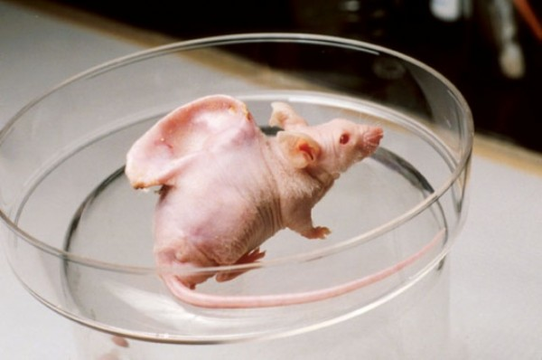
Genetic Transfer: Methods
Xenotrans-
plantation – a process of transplanting an organ of an organism to another.

Slide 11
☺ END ☺

Slide 12
ASSIGNMENT:
Answer all “Fill in the Blanks” on your book Chapter 13
pages 324-325

