Slide 1
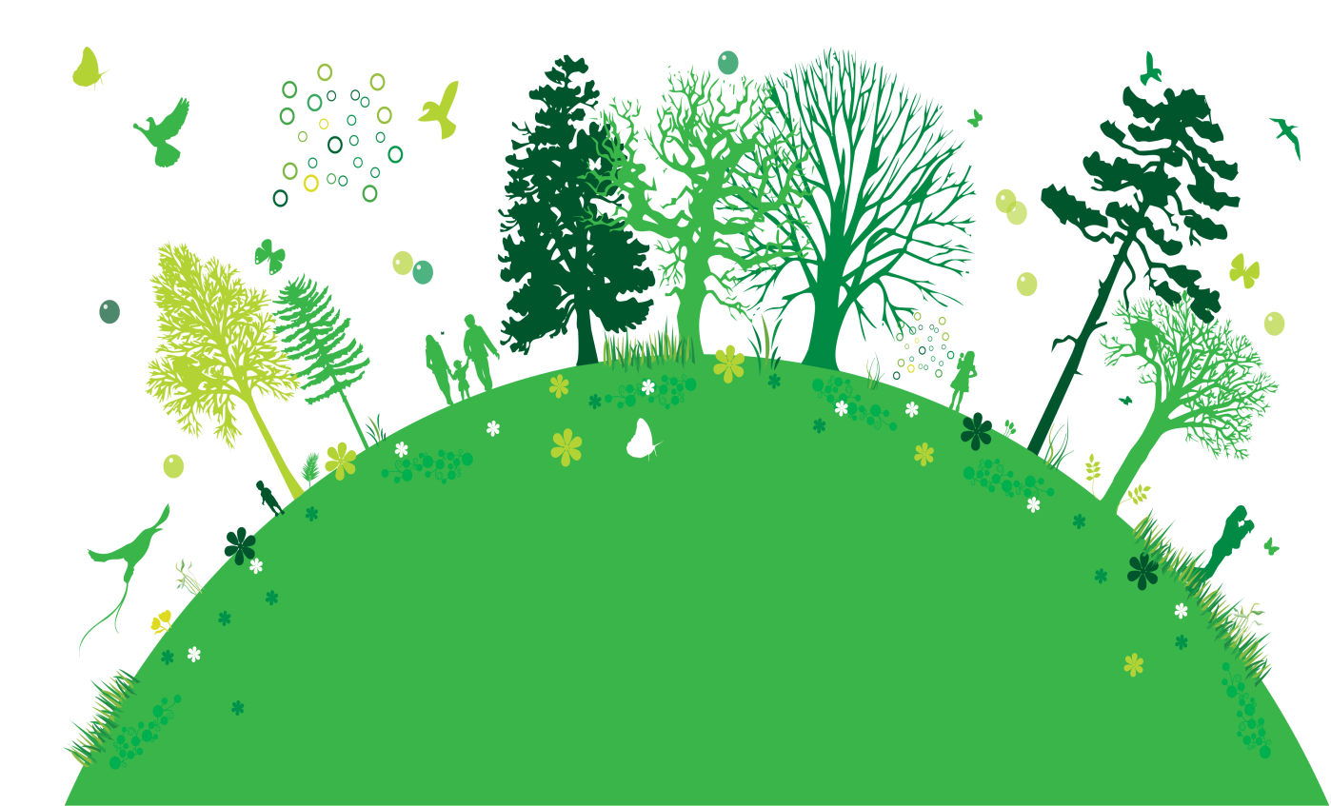
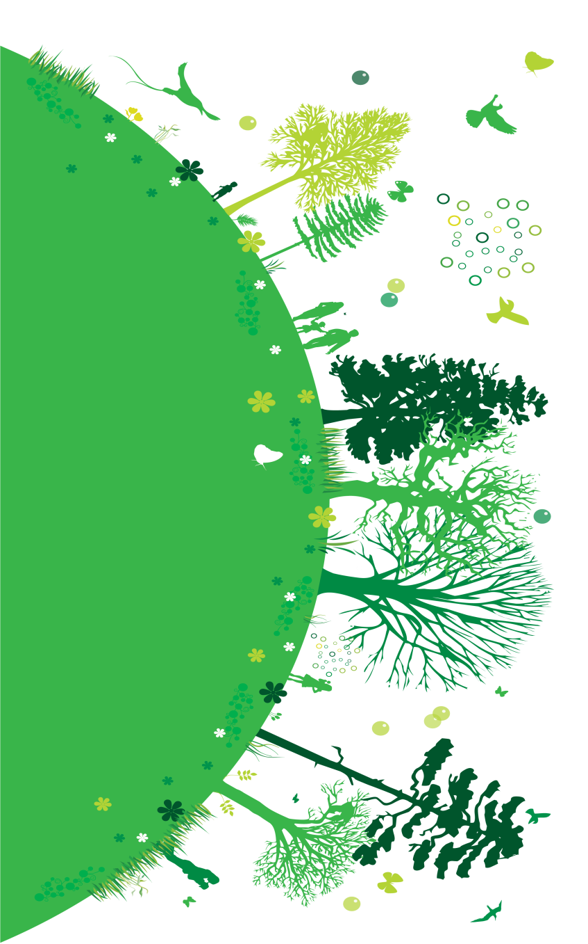
Biotechnology in
Prepared by:
Jomar Mercado Urbano

Slide 2
A branch of science concerned with the interrelationship of organisms and their environments.

Slide 3
INTRODUCTION
Ecological or Environmental Biotechnology
is the application of biotechnology for solving environmental problems, both in the environment or in man made ecosystems.

Slide 4
Why Environmental Biotechnology?
It is needed to:
eliminate the hazardous wastes produced by our other technologies.
distinguish between similar species and ensure species are not at risk of extinction.
create alternative energy sources (i.e. Biofuel)

Slide 5
Contaminants Released into the Environment
• Solvents
• Pesticides
• Herbicides
• Fungicides
• Insecticides
• Petrochemicals
• Explosives
• Heavy metals

Slide 6
Research Areas of Environmental Biotechnology
• Biosensors
• Bioindicators
• Bioremediation
• Phytoremediation
• High Yield Farming
• Biodiesel

Slide 7
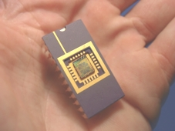
BIOSENSORS
They are devices that combine biological and electronic systems to detect or measure small amounts of specific substances, including environmental pollutants.

Slide 8
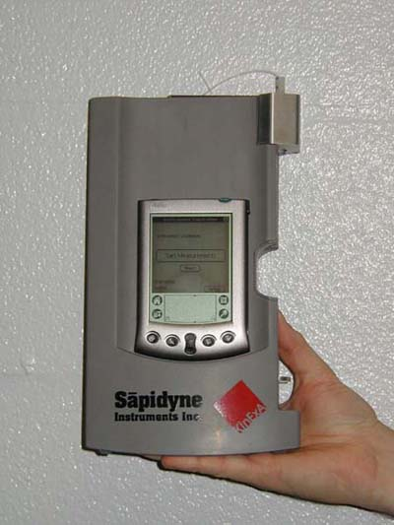
Current uses of biosensors include:
Detecting levels of toxins in an ecosystem
Detecting airborne pathogens
(i.e. anthrax)
Monitoring blood glucose levels

Slide 9
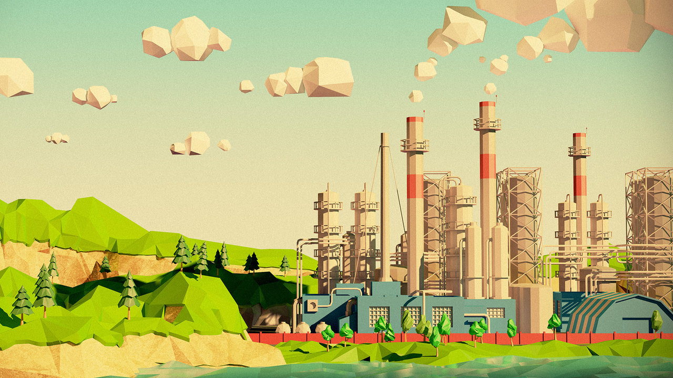
Elements of a Biosensor

Slide 10
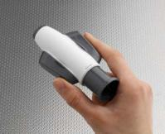
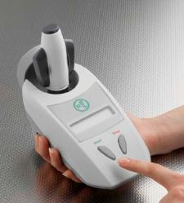
Example Of A Biosensor For Detecting Toxins Of Plants

Slide 11
BIOINDICATORS
Bioindicator is a living organism that is used in estimation of the conditions of the environment.
Bioindication is a process of detection of ecologically significant natural and anthropogenic stresses on the basis of organisms’ responses directly in the habitat.

Slide 12
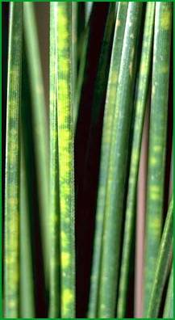
EXAMPLES:
Pinus sylvestris indicates atmosphere pollution. It indicates chlorosis - a destruction of chlorophyll.
The presence of frogs may
indicate a clean
wetland area.

Slide 13
BIOREMEDIATION
“BIO-” means Life.
“-REMEDIATION” means Fix or Cure.
Any process that uses microorganisms, fungi, green plants or their enzymes to return the natural environment altered by contaminants to its original condition.

Slide 14
Why Use Bioremediation?
To clean up oil spills by the addition of nitrate and/or sulfate fertilizers to facilitate the decomposition of crude oil by bacteria.
To attack specific soil contaminants, such as degradation of chlorinated hydrocarbons by bacteria.

Slide 15
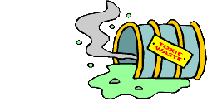
Example: Oleophilic Bacteria
When ships meet with an accident, a tremendous amount of oil is leaked into the water and is often washed ashore. What would happen?
But.. Researchers developed an oil consuming bacteria (oleophilic). They consume and dissolve the heavy stick oil that clogs up beaches after oil spill.

Slide 16
PHYTOREMEDIATION
“PHYTO-” means Plants.
“-REMEDIATION” means Fix or Cure.
It is the process of decontaminating or stabilizing polluted area using plants.
Plants absorb complex materials such as heavy metals, solvents, hydrocarbons, pesticides, radioactive materials, explosives, nitrates, crude oil, runoff from landfills, and organic pollution that could burden surface waters

Slide 17
Example: Chernobyl Sunflower Project - 1994
It is carried out by Phytotech, a phytoremediation company in Monmouth Junction, N.J.
Rafts with sunflowers growing on them float on a small pond at the Chernobyl nuclear accident site in the Ukraine.

Slide 18
Example: Chernobyl Sunflower Project - 1994
The roots dangle in the water to suck up the cesium 137 and strontium 90.
This sunflower project is one of many international efforts at phytoremediation.

Slide 19
ADVANTAGES:
Low cost
Ability to harness natural processes
Reduction of Environmental stress
Use of attractive plants

Slide 20
DISADVANTAGES:
Time
Inapplicability to certain contamination situations
Public concerns

Slide 21
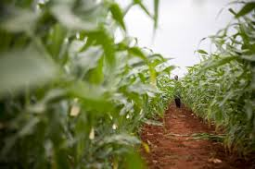
High Yield Farming
The process of maximizing, breeding and cultivating crops to increase their production yields for the health and well-being of the world’s ever growing population.

Slide 22
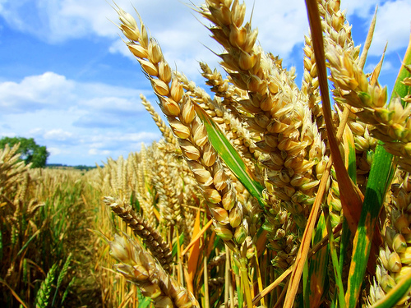
High Yield Farming
HIGH YIELD CROPS – is any cultivated plant, fungus, or algae that is harvested for food, clothing, livestock fodder, biofuel, medicine or other uses that produces a significantly large amount rather than that of an ordinary farm crop.

Slide 23
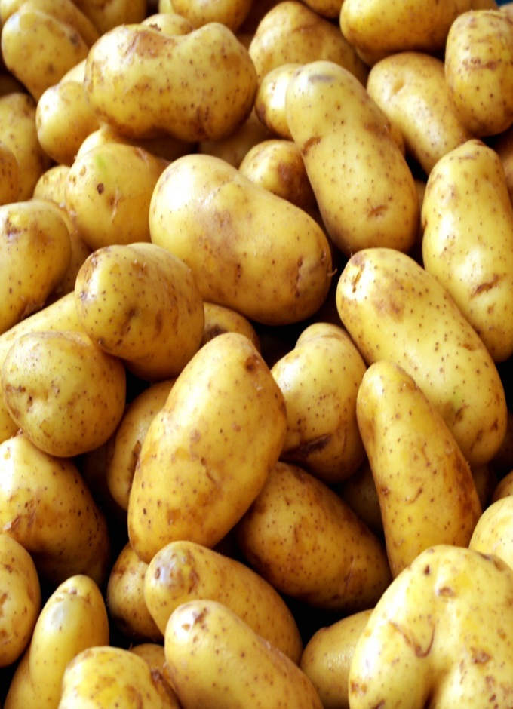
Example: Potatoes
The potato (Solanum tuberosum) is the New World’s second gift to world agriculture. The white potato is capable of nourishing large populations, especially in cooler regions where many other crops will not grow. It contains large stores of energy, high-quality protein, and valuable minerals and vitamins.

Slide 24
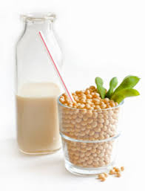
Example: Soybeans
The soybean or soya bean is a species of legume native to East Asia, widely grown for its edible bean which has numerous uses. The plant is classed as an oilseed rather than a pulse by the UN Food and Agricultural Organization.

Slide 25
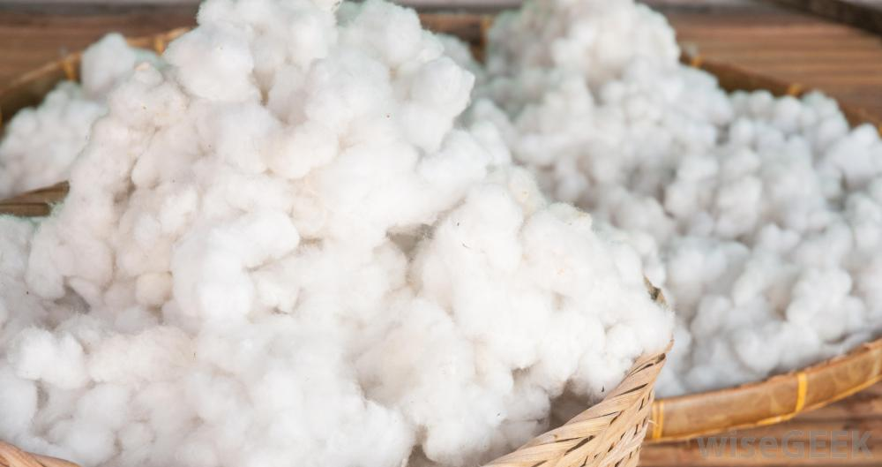
Example: Potatoes
A soft, fluffy staple fiber that grows in a boll, or protective capsule, around the seeds of cotton plants of the genus Gossypium in the family of Malvaceae. The fiber is almost pure cellulose. Under natural conditions, the cotton bolls will tend to increase the dispersion of the seeds.

Slide 26
Why Use High Yield Farming?
Increases Yield 6-8 Times!
Yield becomes pure in quality.
Slows down pace of Global Warming!

Slide 27
BIODIESEL
Biodiesel is a form of diesel fuel manufactured from vegetable oils, animal fats, or recycled restaurant greases. It is safe, biodegradable, and produces less air pollutant.

Slide 28
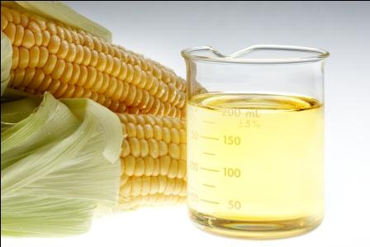
Example: Ethanol
Biodiesel made from sugar canes or corn.
Primarily used in cars, ethanol is a type of alcohol and is most commonly made from corn or sugarcane. Based on sugars.

Slide 29
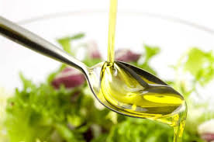
Example: Soybeans
Vegetable oil is used in several old diesel engines that have indirect injection systems. This oil is also used to create biodiesel, which when mixed with conventional diesel fuel is compatible for most diesel engines. Used vegetable oil is converted into biodiesel.

Slide 30
ADVANTAGES:
Biofuels are a renewable energy source.
Some consider the use of biofuels as carbon neutral since the carbon produced.
Biofuel can help reduce the dependence on foreign oils.
DISADVANTAGES:
It requires changes in machineries.
Less land for food production.

