Slide 1
LEV VYGOTSKY’S
SOCIO-CULTURAL THEORY

Slide 2
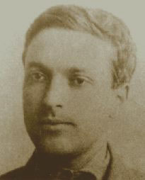
Vygotsky’s Sociocultural theory
Born on November 5, 1896 in Byelorussia (Soviet Union)
He was first educated as lawyer and a philologist
He began his career as a psychologist in1917 and only pursued this career for 17 years before his death from tuberculosis in 1934.

Slide 3
More Knowledgeable Other
The MKO is somewhat self-explanatory; it refers to someone who has a better understanding or a higher ability level than the learner, with respect to a particular task, process, or concept.

Slide 5
